Slide 1
Technical English for Computer Science
Week 1
Dr. Nur Banu OĞUR

Slide 2
Evaluation
Success rate within the term: %50
Midterm : %40
Homework: %20
Project : %40
Success rate end of the term (Final) : %50

Slide 3
What is a computer?
A computer is a machine with an intricate network of electronic circuits that operate switches or magnetize tiny metal cores.
The switches are capable of being in one of two possible states, that is, on or off.
The machine is capable of storing and manipulating numbers, letters and characters.
The basic idea of a computer is that we can make the machine do what we want by inputting signals that turn certain switches on and turn others off.

Slide 4
What is a computer?
The basic job of computers is the processing of information. For this reason, computers can be defined as devices which accept information in the form of instructions called a program and characters called data, perform mathematical and/or logical operations on the information, and then supply results of these operations. The program, or part of it, which tells the computers what to do and the data, which provide the information needed to solve the problem, are kept inside the computer in a place called memory.

Slide 5
What is a computer?
Computers are thought to have many remarkable powers. However, most computers, whether large or small have three basic capabilities. First, computers have circuits for performing arithmetic operations, such as: addition, subtraction, division, multiplication and exponentiation. Second, computers have a means of communicating with the user. After all, if we couldn’t feed information in and get results back, these machines wouldn’t be of much use. However, certain computers (commonly minicomputers and microcomputers) are used to control directly things such as robots, aircraft navigation systems, medical instruments, etc.

Slide 6
What is a computer?
Some of the most common methods of inputting information are to use punched cards, magnetic tape, disks, and terminals. The computer's input device (which might be a card reader, a tape drive or disk drive, depending on the medium used in inputting information) reads the information into the computer.

Slide 7
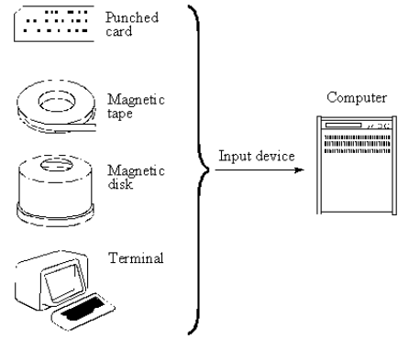
What is a computer?
For outputting information, two common
devices used are a printer which prints the
new information on paper, or a CRT display
screen which shows the results on a TV-like
screen.

Slide 8
What is a computer?
Third, computers have circuits which can make decisions. The kinds of decisions which computer circuits can make are not of the type: “Who would win a war between two countries?” or “Who is the richest person in the world?” Unfortunately, the computer can only decide three things, namely: Is one number less than another? Are two numbers equal? and, Is one number greater than another?

Slide 9
What is a computer?
A computer can solve a series of problems and make hundreds, even thousands, of logical decisions without becoming tired or bored.
It can find the solution to a problem in a fraction of the time it takes a human being to do the job.
A computer can replace people in dull, routine tasks, but it has no originality; it works according to the instructions given to it and cannot exercise any value judgments.
There are times when a computer seems to operate like a mechanical 'brain', but its achievements are limited by the minds of human beings.
A computer cannot do anything unless a person tells it what to do and gives it the speed of light, a computer can carry out vast numbers of arithmetic-logical operations almost instantaneously.
A person can do everything a computer can do, but in many cases that person would be dead long before the job was finished.

Slide 10
What is a computer?
Decide weather the following statements are true or false.
1. A computer can store or handle any data even if it hasn't received information to do so.
2. All computers accept and process information in the form of instructions and characters.
3. The information necessary for solving problems is found in the memory of the computer.
4. Not all computers can perform arithmetic operations, make decisions, and communicate in some way with the user

Slide 11
What is a computer?
5. Computers can still be useful machines even if they can't communicate with the user.
6. There are many different devices used for feeding information into a computer.
7. There aren't as many different types of devices used for giving result as there are for accepting information.
8. Computers can make any type of decision they are asked to.
9. Computers can work endlessly without having to stop to rest unless there is a breakdown.

Slide 12
What is a computer?
Refer back to the text and find the synonyms.
1. complex ………….…………
2. fundamental …………………
3. a way …………………
4. uninterested …………………
5. Accomplishments …………………

Slide 13
What is a computer?
Refer back to the text and find the antonyms.
large …………………
receiving …………………
reject …………………
unusual …………………
small …………………

Slide 14
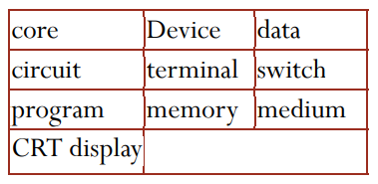
What is a computer?
Complete the following statements with the appropriate words.
Every computer has ………………… for performing arithmetic operations, operating ………………… or magnetized ………………… .
A …………………with a screen is normally referred to as a ………………… unit.
A computer is a ………………… that processes information in the form of ………………… and …………………and can store this information in a ………………… .
Card readers, tape drives, or disk drives are different ………………… for inputting information.

